Slide 1
Found Objects
The objective here is to learn about the concepts and principles behind art created with found objects through discussion and a workshop. And to understand the use of materials and what they can symbolise in found object art.

Slide 2
Found objects-
Inconsequential objects found just about anywhere, with interesting origins, history, or purposes, or exhibiting elements or principles of design or other aesthetic qualities. They have not been produced to use as art materials, but with other specific purposes.
Found object art-
Art assembled from these various found objects.

Slide 3
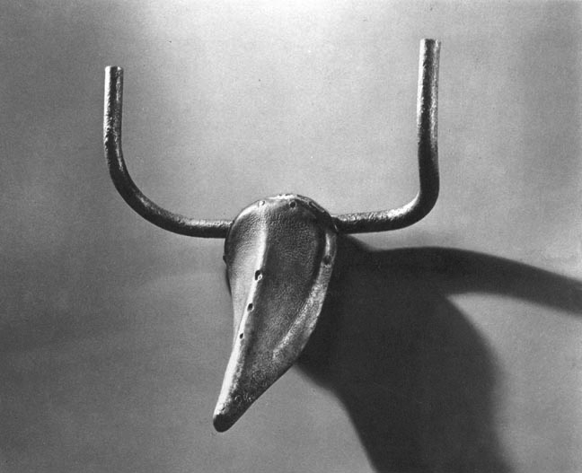
Pablo Picasso; Bull's Head; 1943; Bronze cast of parts of bicycle; 42 x 41 x 15 cm
Notes:
A visual joke. Brings together two elements of a manmade object (discarding all the other bits) what is left is ironically a symbol of nature, a bull.
And what do bulls represent in culture? Masculinity, power, strength.
The irony of this piece is that bikes, ie machines are also symbols of masculinity, power and strength, but to represent that, Picasso disabled the bike and used its component, taking it away it’s masculinity, power and strength. But then reinstating that in the form of this sculpture.

Slide 4
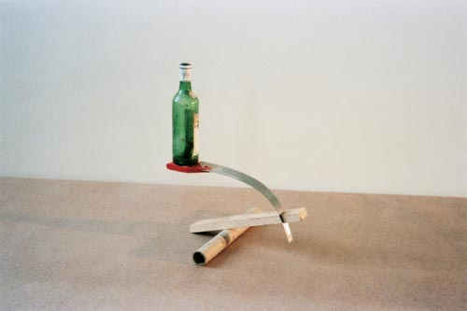
Fischli and Weiss; Equilibres- quiet afternoon; 1984-87
Notes:
Makes the objects into comedy characters. This work exists only as a photograph, they made a number of these types of work and they all fell apart seconds after the photo was taken. It is full of potential energy. The objects have the potential for life and are thus given characters. They are like clowns in a circus. It makes a joke out of the human desire and need for objects in our everyday lives.

Slide 5
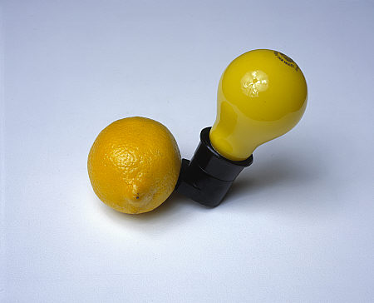
Joseph Beuys; Capri Batterie; 1985; Yellow light bulb in black socket, lemon; 18.5 x 18.5 x 18.5 cm
Notes:
metaphor of the ecological balance of civilization. It implies that electricity flows from the fruit, lighting up the bulb. It was made in the last year of his life while he was recovering from a lung illness. This information gives the work a healing charge. It is a marriage of art, science and nature.

Slide 6
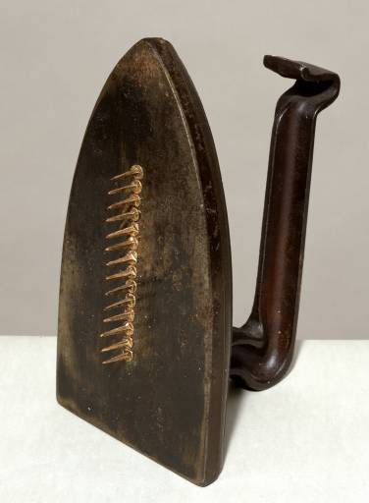
Man Ray; Cadeau 1921; Iron and nails; 17.8cm x 9.4cm x 12.6cm
Notes:
Cadeau- gift in French. It is a visual pun. An ironic play on what these objects are usually used for and represent. An iron is used to press clothes, with nails attached it becomes a threatening and violent object at odds with the work’s title- ‘Gift’
It expresses the opposing subconcious desires to sooth and harm and in doing so anticipates the Surrealist movement.

Slide 7
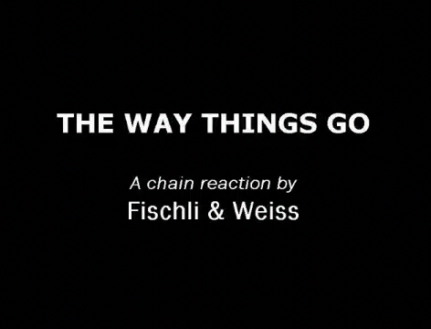
Still from The Way Things Go (1987) by Fischli and Weiss
Notes:
There are opposing relationships at play here. That of good and evil.. The good is playful and curious, the evil is destructive. Countenancing this, they are quoted as saying: ‘On the other hand, every object in our installation is good if it functions, because it then liberates its successor, gives it the chance of development. Not destructive in that sense.'

Slide 8
Discuss the artwork ‘The Way Things Go’ by Fischli and Weiss
How are the meanings of the objects changed when placed in a new context?
What do you think is the purpose of the work?
Who do you think is the intended audience?
What skills do you think were involved in making this work?
Why do you think these particular objects were used?
What is the relationship between the objects?
- Do you think the objects have a history in the artist’s life?
How do the objects that were used shape the overall message/effect of the piece?
What is the purpose of using found objects to make sculpture as opposed to conventional materials like clay, metal, or wood?
Notes:
10 mins

Slide 9
Discuss the objects you have brought
What is interesting about the objects? What are their original purposes? What are they made of? Where were they found? Identify any principles or elements of design within each object.
You should also write the answers to these questions about your objects in your research books.
Notes:
30 mins

Slide 10
You are now going to spend time making quick sculptures in groups of 4 or 5 with your objects which represent the following words.
The making of each sculpture will be timed to 5 minutes. We will discuss each sculpture afterwards.

Slide 11
HAPPINESS

Slide 12
BOREDOM

Slide 13
LOVE

Slide 14
CALM

Slide 15
FLIGHT

Slide 16
SCARY

Slide 17
TIRED

Slide 18
HONESTY

Slide 19
LONGING

Slide 20
JOURNEY

Slide 21
ANTICIPATION

Slide 22
BALANCE

Slide 23
NOTHINGNESS

Slide 24
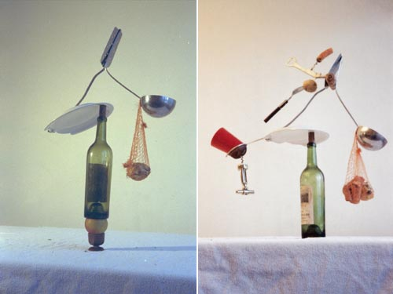
Home assignment (18th Oct – 1st Nov)
FOUND OBJECTS
Research the work of an artist who has used found objects.
Also answer following questions:
- How do you value found object art?
- How would you compare a piece of art made from found objects to another fine art piece, for example a bronze sculpture?
- Do you value both art works the same? Explain why/why not?
- Is found art beautiful? Explain why/why not?
Use found objects to make a sculpture, using the words ‘HARMONY and DISCORD’ as your concept.
A successful design should incorporate objects of either formal or emotional significance, in a way where the whole becomes more important than its individual parts. Find objects which you consider significant, and then put them together, using the words ‘HARMONY and DISCORD’ to help you, transcending them to a higher level of visual understanding.
Your piece should display a good understanding of Form, Space, Content, and must be carefully constructed.
You are able to use whatever materials you like to fix the objects together.
Consider the sculptures you have been making today, think about the problems you may have faced in putting the objects together. Think about how you would have solved these problems had you other materials at hand. Use these thoughts and experiences when making your home assignment.
Background image- Fischli and Weiss; Equilibres- quiet afternoon; 1984-87,

Slide 25
Fischli & Weiss quote on Slide 7 taken from:
http://www.medienkunstnetz.de/works/the-way-of-things/

