Slide 1
Plaster Casting, 8th November

Slide 2
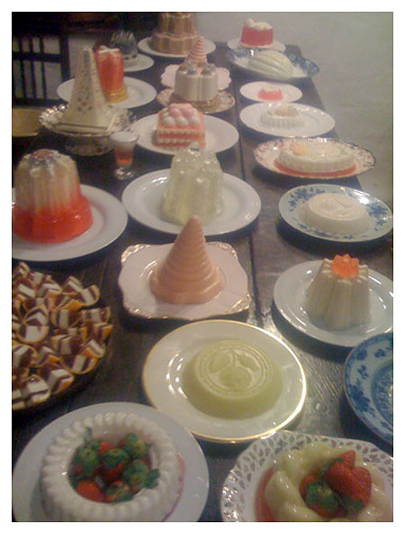
Casting is the process by which a liquid is poured into a mould which contains the hollowed cavity of the desired shape. The liquid is left to solidify and then taken from the mould.
The process in which jelly is made is casting.

Slide 3
Casting is used to create complex shapes and textures that would otherwise be too difficult and time-consuming to create.
This can be done with many substances but it must be possible to activate a transition from liquid to solid in the substance to be able to make a casting with it.

Slide 4
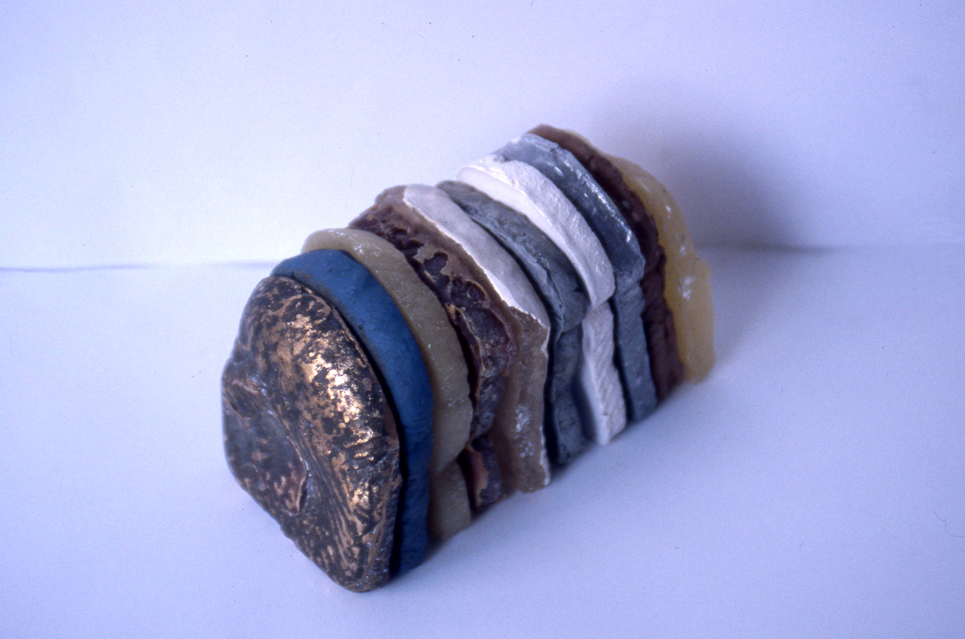
Loaf; vinamold, wood filler, latex, resin, silicone filler, plaster, aluminium, clay, wax; 2001

Slide 5
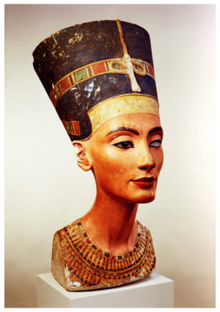
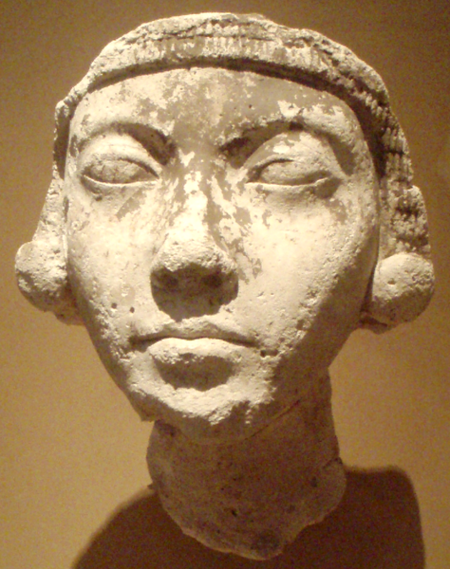
Plaster casting which is what we are going to be doing today dates back to the Ancient Egyptians.
They used the material in the preservation process of their mummies to plaster their pyramids and also in art.
An early plaster artisan is the Egyptian, Thutmose. It is said he was the official court sculptor of Egyptian Pharaoh Akhenaten around 1000 BC. These are plaster cast works:
Thutmose's bust of the Queen, Nefertiti
Thought to be Kiya, one of Akhenaten’s other wives

Slide 6
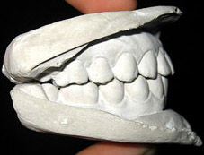
The casting technique has developed to this day and has a vast array of uses.
Dentists use it to take casts of patients mouths to fit braces or replace teeth.
They use a material called alginate to make the mould. It is is a fine rubber that picks up minute details. This is a temporary mould and produces one unique cast.

Slide 7
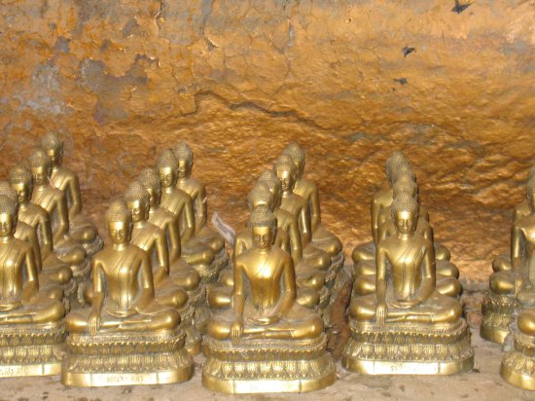
Casting is vital to industry and is used in the mass production of things.. The buddha statue being an example.

Slide 8
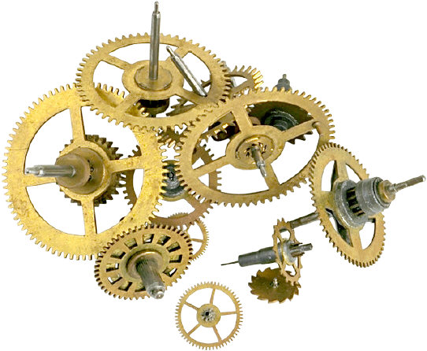
machine and clock parts

Slide 9
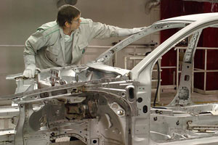
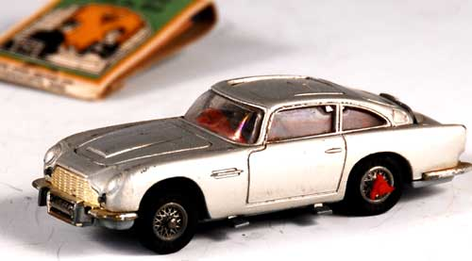
Car parts to toy cars

Slide 10
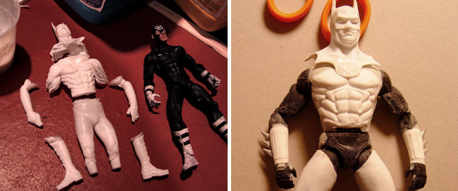
figurines

Slide 11
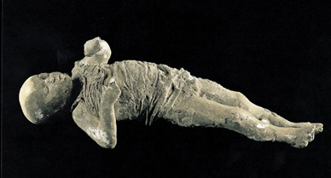
Giuseppe Fiorelli started using a plaster casting technique in an excavation of Pompeii in the 1860s.
The city and its inhabitants were destroyed when Mount Vesuvius erupted in 79 AD. The ash settled to about 6 metres thick and preserved the city in the state in which it destroyed it. It solidified and over the 1500 years that followed until it was discovered, the organic matter decomposed, leaving hollows in the ash.
Into these hollows, Fiorelli poured liquid plaster and extracted the solidified version, like this child found in one of the houses.
Notes:
Discovered in 1599
Ironic and sad- in getting these forms from the site… it is being destroyed.
It is like a set of unique moulds

Slide 12
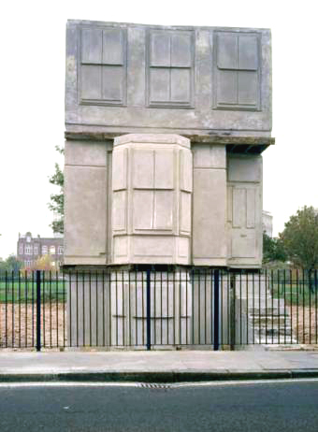
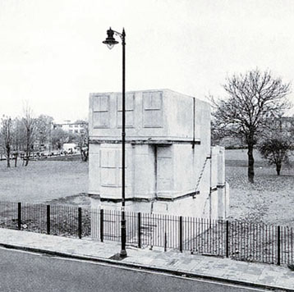
Rachael Whiteread’s ‘House’, 1993
Notes:
A concrete cast of a Victorian terraced London house. It was a simple idea but hard to execute.. The walls of the house formed the mould, liquid concrete was poured and left to solidy.
But what was produced was a ghost of the house, no walls, no roof, no doors or windows.
It is reminiscent of the technique used by Fiorelli in Pompeii. It spoke of archaeology but in much more recent times… being applied to something, a building, which was so familiar. It brought the idea of ancient history to a residential street of London. It made history seem closer, and like it was a part of everyone.
Stupidly the council knocked the piece down. That is what was agreed before she made it and they insisted that the agreement was stuck to.

Slide 13
Todays lesson, 8th November
is based on using a basic form of casting.. Pressing objects and materials into blocks of clay to create a landscape in relief.
This is the start of your final project. Your landscape should be based on the celestial body you have been assigned by Design 1.
Firstly experiment individually, when you have a couple of examples come together into your group to work on your landscape collectively.
Experiment with different objects and materials and tools and also what you can do with your hands.
This is a quick project so you should hopefully be able to get more than one of these done.
You will be marked on how innovative your use of materials and objects is, and also how well it speaks of your assigned celestial body.

Slide 14
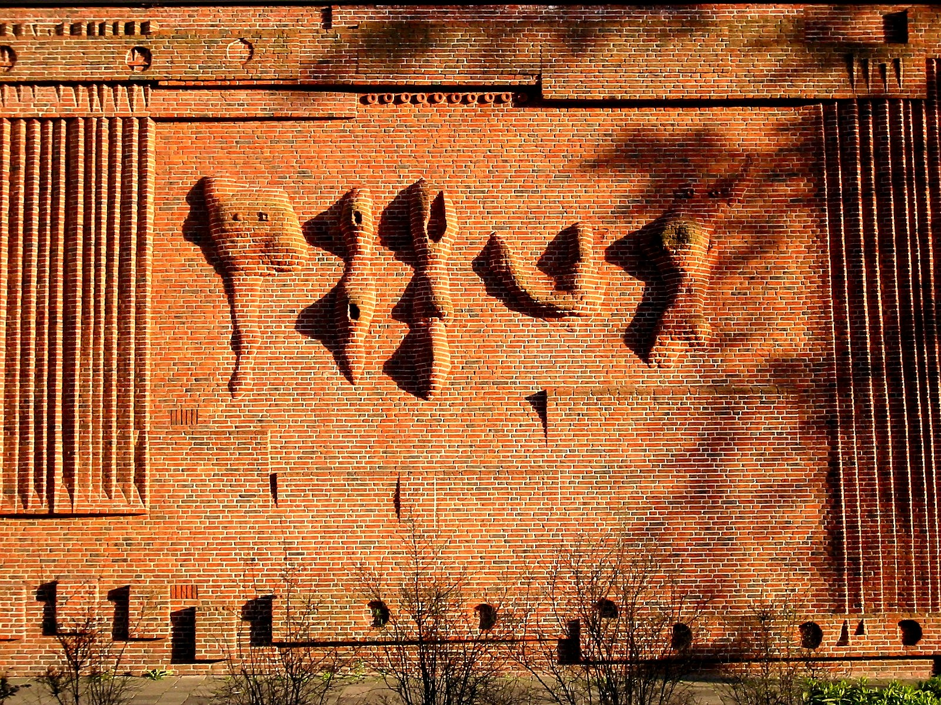
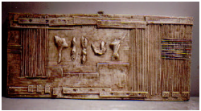
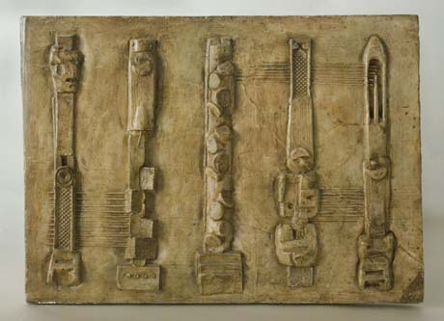
Henry Moore worked in a similar way when planning some of his works and sometimes they formed the finished work.
Plaster Wall Relief: Maquette No. 1; 1955, 25.5cm x width 57cm became this (top right)
At the Bouwcentrum in the rebuilt city center of Rotterdam in The Netherlands; ‘Wall Relief no. 1; 1955; made from bricks; 18,60 m x 8,40 m
Wall Relief: Maquette No.5; plaster (dimensions and year unknown)

