Slide 1
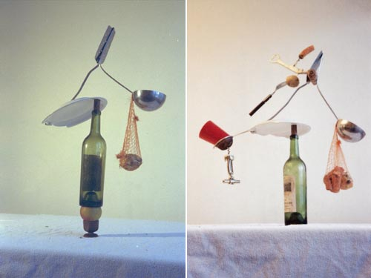
Home assignment (18th Oct – 1st Nov)
FOUND OBJECTS
Research the work of an artist who has used found objects.
Also answer following questions:
- How do you value found object art?
- How would you compare a piece of art made from found objects to another fine art piece, for example a bronze sculpture?
- Do you value both art works the same? Explain why/why not?
- Is found art beautiful? Explain why/why not?
Use found objects to make a sculpture, using the words ‘HARMONY and DISCORD’ as your concept.
A successful design should incorporate objects of either formal or emotional significance, in a way where the whole becomes more important than its individual parts. Find objects which you consider significant, and then put them together, using the words ‘HARMONY and DISCORD’ to help you, transcending them to a higher level of visual understanding.
Your piece should display a good understanding of Form, Space, Content, and must be carefully constructed.
You are able to use whatever materials you like to fix the objects together.
Consider the sculptures you have been making today, think about the problems you may have faced in putting the objects together. Think about how you would have solved these problems had you other materials at hand. Use these thoughts and experiences when making your home assignment.
Background image- Fischli and Weiss; Equilibres- quiet afternoon; 1984-87,

