Slide 1
Week 2, Working with Cardboard
Monday 4th October

Slide 2
Last week?

Slide 3
What did you learn?

Slide 4
Upcycling
Upcycling is the process of converting waste materials or useless products into new materials or products of better quality or a higher environmental (or monetary) value
Definition from Wikipedia

Slide 5
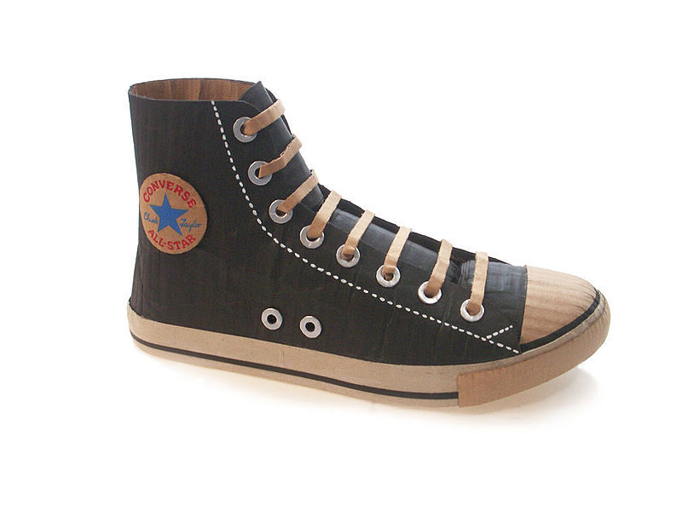
Michael Leavitt
Michael Leavitt uses cardboard to make to-scale versions of cultural ephemera, mainly shoes.
He says of his work, “Shoes are so intimately linked to our visual culture. They’re a necessity that we still get to have fun buying and wearing… It's ironic to use a cheap disposable material like cardboard. Cheap, disposable material makes an expensive product, oddly resembling the manufacturing of boutique footwear. The simple image of the cardboard shoe speaks humorously and clearly on consumerism."
M.Leavitt, Chuck Taylor, 2009

Slide 6
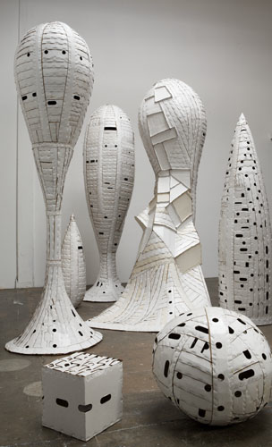
Ann Weber
Ann Weber uses cardboard and glue to create organic and figurative work.
The glue is integral to the work. It allows Weber to shape and coat the material.
THE WEDDING PARTY
2009 found cardboard, staples, polyurethane seven pieces ranging in size from 10 x 10 x 10 inches to 96 x 52 x 46 inches

Slide 7
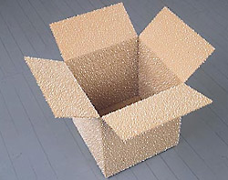
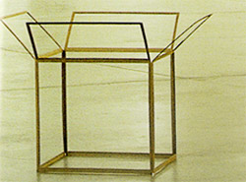
Tom Friedman
'untitled (box balls)', 2002
cardboard box and styrofoam balls
'open' 2002
an open box
From a one man show at the Prada Foundation, Milan in 2002
Friedman says 'I make work for specific exhibitions. I move from piece to piece, working on each a little at a time, my ideas develop through this process. I know I am finished when each piece achieves a sense of conceptual clarity and when the relationships between the works keep building upon each other.’

Slide 8
Tom Friedman is linked with the Conceptual Art and Arte Povera movements of the 1960s.
The term Arte Povera literally translates as ‘poor art’. The poor reference here denotes the movement’s exploration of a wide range of materials beyond the traditional ones of oil paint on canvas or bronze statues.
‘Arte Povera denotes not an impoverished art, but an art made without restraints, a laboratory situation in which any theoretical basis was rejected in favour of a complete openness towards materials and processes.’
Reference- Tate Online

Slide 9
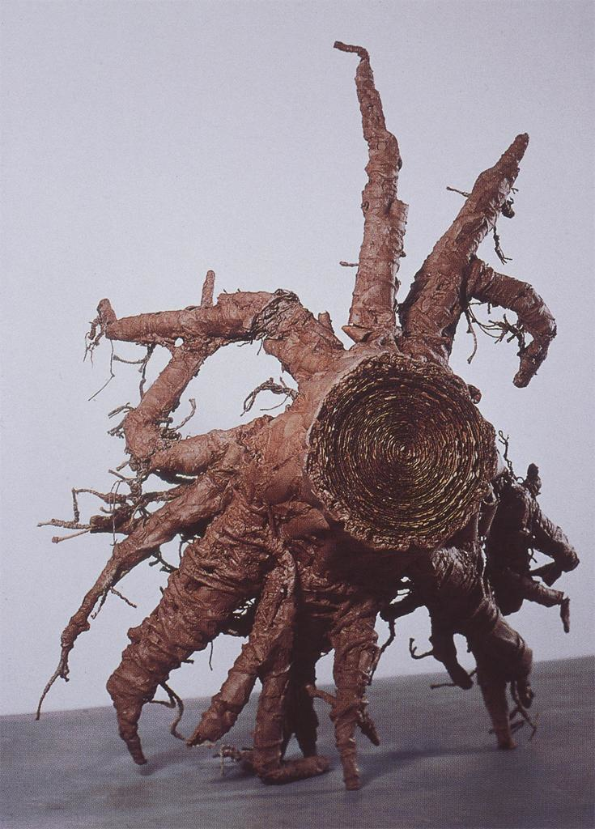
Tim Hawkinson
Tim Hawkinson uses cardboard amongst other materials to create remarkable Trompe l’Oeil pieces of work.
Root Ball, 1999, Paper, cardboard, glue, string
Notes:
It is a clever piece of work, more clever than it looks at first glance. Discuss. At first glance in a gallery setting one would see this as a sculpture, possibly bronze. A nice trompe l’oeil piece of work. On closer inspection one sees it is actually cardboard which has been painstakingly coiled and glued and sculpted.
One then realises the importance of the material and the fact it is in cahoots with the subject. It is self-reflexive, the subject is a tree root, and it is made out a material which it produces- cardboard. It thus becomes a conceptual piece of work.

Slide 10
The artists I have included here are all very different, their main connection is the raw material, cardboard- which denotes their desire to create something beautiful and thought provoking out of a boring mundane material. Through using this material they are all promoting an awareness of human production and consumption.
I wanted to show you its versatility- materially and conceptually.
There’s so much that can be done of importance and beauty with something regarded as rubbish.

Slide 11
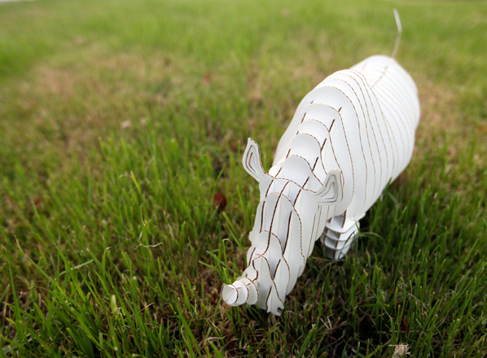
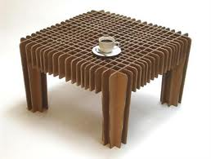
Monday 4th October
You will use a cutting and slotting technique to create 3D models. It is a craft technique which has been used by various people.
Cardboard Safari
David Graas

Slide 12
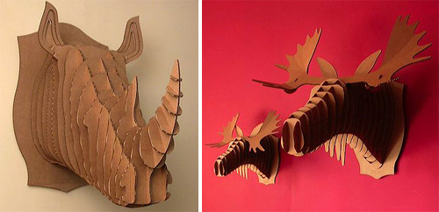
Cardboard Safari reference trophy heads of animals which are known for being poached and shot in real life, and create much kinder and ecologically sound versions in cardboard.
You will take the creature you have created and design a 3D model based on this technique. You will then create the model in cardboard.
Be imaginative!
Make the technique work for your own creature. Make it your own piece of work. Think how you can stretch the technique to work for the legs, the ears and any other parts. Make the material and form work together.
Cardboard Safari

